Slide 1
ENGR-304-L
Hardware Lab 01

Slide 2
Agenda
Attendance
Recap
FPGA & VHDL
Block Diagrams
Quartus
Getting Started

Slide 3
Recap
IO Devices – Polling vs Interrupts
The ISR & Main Routine
Control Registers & New Instructions

Slide 4
FPGAs
Field Programmable Gate Array Devices
General purpose hardware configured as specific circuitry
Hardware iterations are expensive
Generic and re-flashable hardware opens many possibilities
Educational tools
Development tools
Nonphysical hardware upgrades
More!

Slide 5
Lab Components
Altera DE2 Board
Windows 10 PC
Quartus
FGPA
Peripheral Devices
(Ex: switches, buttons, hex displays)
Custom System Image
Custom System Image
(Flashed)
Switches
Keys
LEDs
7Seg Displays
Timer

Slide 6
VHDL
VHSIC Hardware Definition Language
Very High Speed Integrated Circuit Hardware Definition Language
“Circuitry as code”
Syntactically similar to Ada
Defines the intended logical behavior of the system hardware, used to flash generic FPGA with specific solution
Tools convert VHDL into FPGA images, analogous to compilers
VHDL is concurrent, logical behaviors are simultaneously applied

Slide 7
VHDL
Entities:
A logical component containing a port of inputs & outputs and an architecture
Ports:
Contain IO signals which may be of type std_logic, std_logic_vector, or others
std_logic refers to typical true/false, high/low, 1/0
Architectures:
Describe the functionality of an entity, how its inputs become its outputs
Signals:
Represent data to be communicated between entities or within an entity
std_logic signals have two possible logical values (true/false)
Processes:
Assist in describing architectures by providing a means for some sequential definition (as opposed to VHDL’s typically concurrent paradigm)

Slide 8
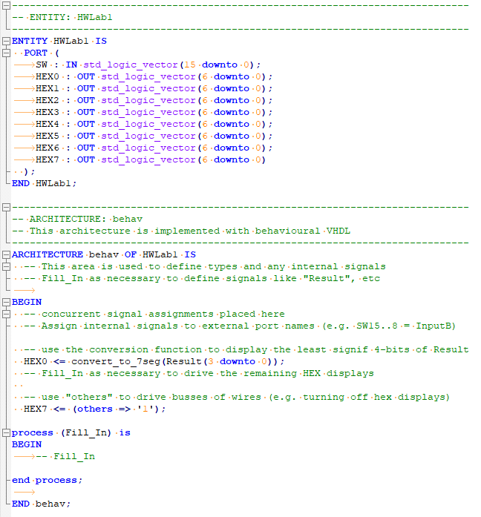
VHDL
Example VHDL template
Resources
http://vhdl.renerta.com/mobile/index.html
http://www.people.vcu.edu/~rhklenke/tutorials/vhdl/modules/m12_23/sld001.htm
http://gmvhdl.com/VHDL.html

Slide 9
VHDL
MUX as a logical component
Pass through one of two inputs based on a third input
4 ways to represent a MUX in VHDL…
A | B | S | F
0 | d | 0 | 0
d | 0 | 1 | 0
1 | d | 0 | 1
d | 1 | 1 | 1

Slide 10
MUX – Selected Signal Assignment
entity Multiplexer is
port( A, B, S : IN BIT ;
F : OUT BIT ) ;
end Multiplexer ;
architecture SelectedSignal of Multiplexer is
begin
with S select
F <= A when'0',
B when OTHERS ;
end SelectedSignal ;

Slide 11
MUX – Conditional Signal Assignment
entity Multiplexer is
port( A, B, S : IN BIT ;
F : OUT BIT ) ;
end Multiplexer ;
architecture ConditionalSignal of Multiplexer is
begin
F <= A when S = '0' else
B ;
end ConditionalSignal ;

Slide 12
MUX – Process If-Else
entity Multiplexer is
port( A, B, S : IN BIT ;
F : OUT BIT ) ;
end Multiplexer ;
architecture ProcessIfElse of Multiplexer is
begin
process( A, B, S )
begin
if S = '0' THEN
F <= A ;
else
F <= B ;
end if ;
end process;
end ProcessIfElse ;

Slide 13
MUX – Process Case Statement
entity Multiplexer is
port( A, B, S : IN BIT ;
F : OUT BIT ) ;
end Multiplexer ;
architecture ProcessCase of Multiplexer is
begin
process( A, B, S )
begin
case S IS
when '0' => F <= A ;
when OTHERS => F <= B ;
end case ;
end process;
end ProcessCase ;

Slide 14
Block Diagrams
Use these in senior design
Systems Engineering vs EE & CE
Block diagrams as a tool:
Assist in communication
Facilitate design of complex solutions
May act as documentation of the design
Are often multi-leveled
Encourage modularization, simulation, and other best practices
Are a fundamental component of MBSE
May act as or support design requirements
Provide the context of a given component, its role in the big picture
… more

Slide 15
Block Diagrams
Depictive syntax ranges from ‘back of the napkin’ to formalized industry standards
Levels of decomposition
Level 0:
The system being diagrammed, its inputs, its outputs, its functionality
Level 1:
Primary sub-systems, their connections, their respective functionalities
Level 2:
Secondary sub-systems, their connections, their respective functionalities
Level N…

Slide 16
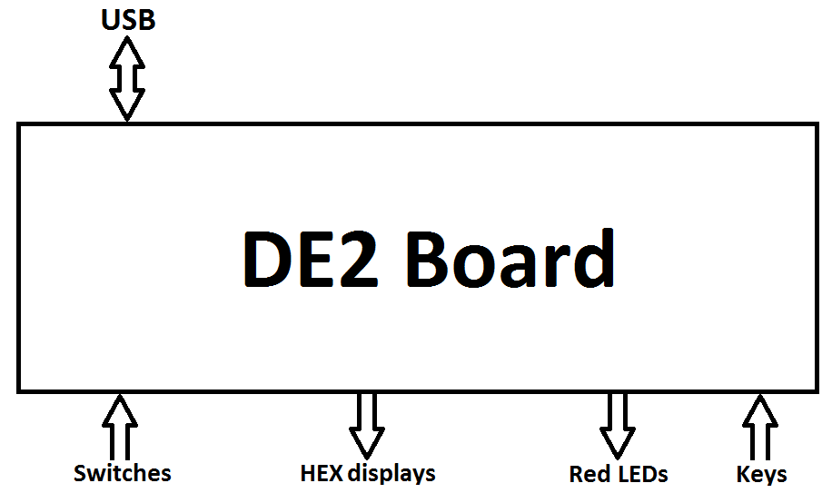
Block Diagram Example – DE2 & NOIS CPU
Level 0

Slide 17
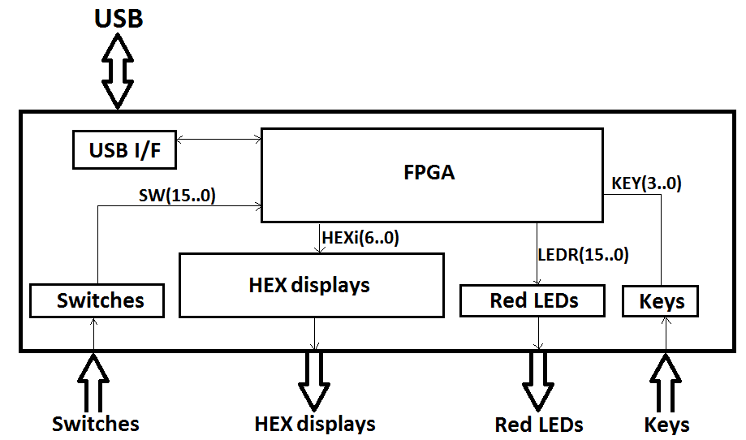
Block Diagram Example – DE2 & NOIS CPU
Level 1

Slide 18
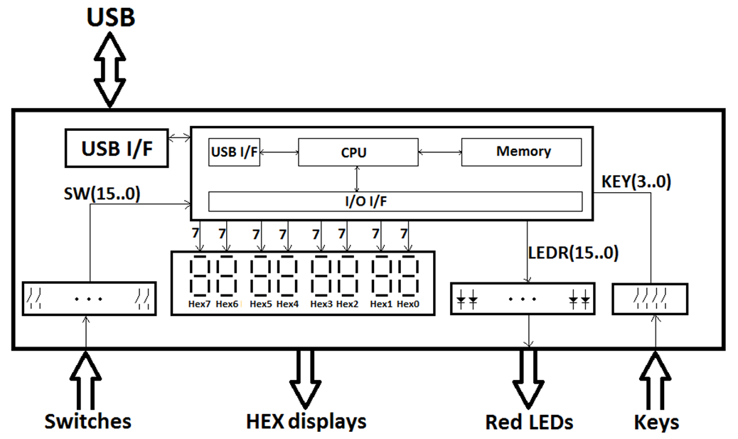
Block Diagram Example – DE2 & NOIS CPU
Level 2

Slide 19
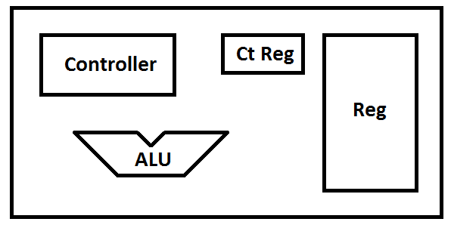
Block Diagram Example – DE2 & NOIS CPU
Level 3
Simplified & Only CPU shown

Slide 20
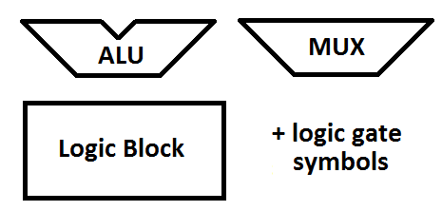
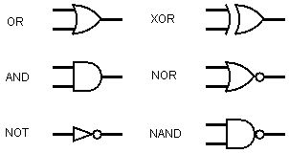
Block Diagrams
Common block diagram symbols for Engr304
http://www.multiwingspan.co.uk/as2.php?page=logic

Slide 21
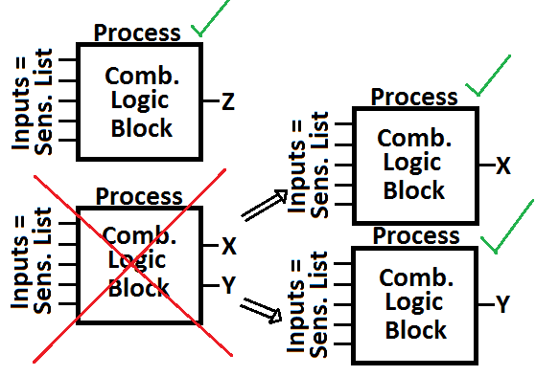
Block Diagrams
VHDL Processes & Block Diagrams
A VHDL process can implement the functionality described by a component in a block diagram
A VHDL process block should have just 1 output, maybe 2 in very simple cases

Slide 22
Quartus
Quartus can build FPGA images from VHDL definitions
Images are specific to a particular device, be sure to select carefully
DE2 FPGAs have fixed pins that are connected to peripheral devices, these must be known ‘ahead of time’ by Quartus to generate an FPGA image that correctly associates the fixed pins to the custom VHDL signals

Slide 23
ModelSim
We will use ModelSim to exercise the system solution on a provided test bench
The test bench drives combinations of inputs into the system at particular times and expects the correct outputs to emerge in response
Often, a test bench and system will be independently developed based on the same requirements. Then, if the system passes the test bench’s tests, there can be a high confidence that it correctly implements the requirements.

Slide 24
Lab HW01 Tips
Think about the different components available for this lab, note that they are all onboard the DE2 board but not all within the FPGA
Consider the difference in the input and output signals, a simple way to state the goal of the system is ‘make the inputs into the outputs’
Think about what conversions or intermediate steps are needed to ‘make the inputs into the outputs’, based on the described requirements of the lab
Draw & label signals conceptually first, and add detail about data representation, bit counts, etc. later
Add your own logical blocks or other commonly used components
Note: VHDL convert_to_7seg() function is provided, a logical block(s)

Slide 25
Getting Started
Setup project directory for HW01 on the H: drive
Download HW01 files from Moodle or S: drive
Start following directions in the lab assignment document

